Slide 1


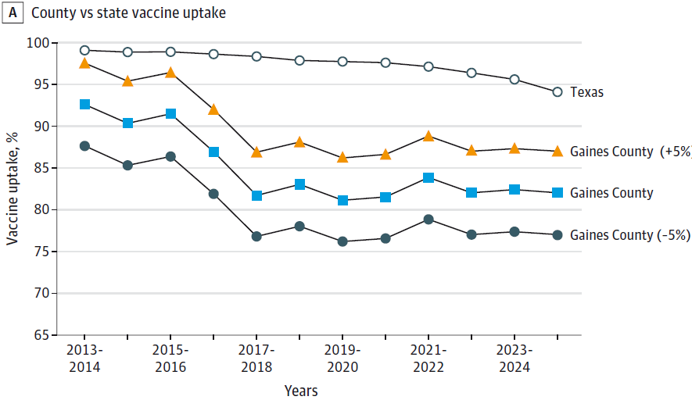
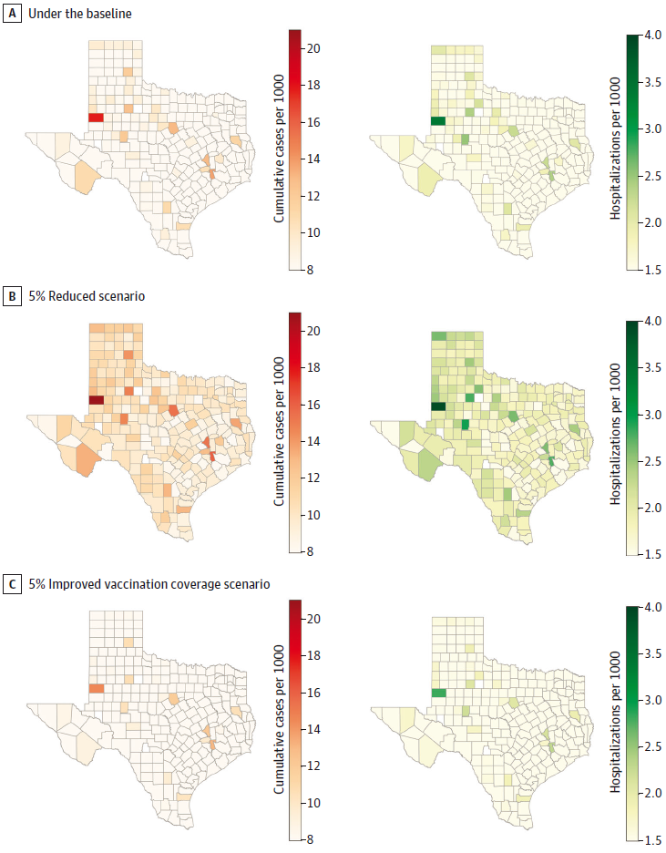
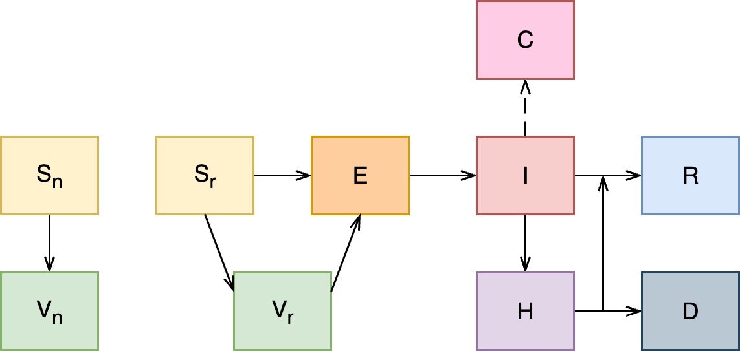
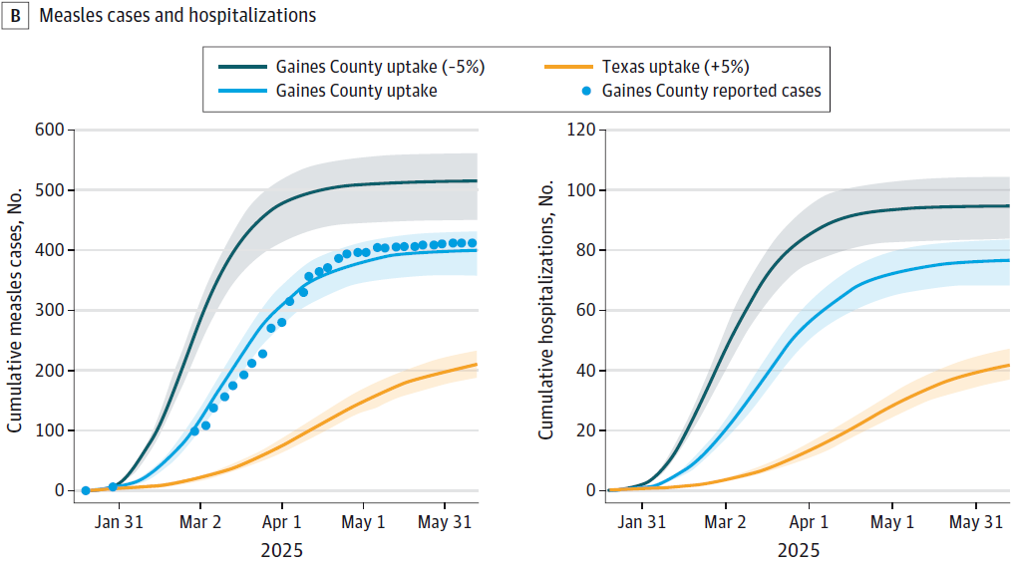
Modeling the impact of MMR Vaccination Strategies on Measles Outbreak in Texas
Authors: Kaiming Bi, Thuy Nguyen, Boya Peng, Trudy Krause, Cecillia Ganduglia Cazaban,
Janelle Rios, Cici Bauer, Catherine Troisi, Eric Boerwinkle, Aanand Naik
Introduction
Hypothetical Scenario Projections in Texas
Measles was a common childhood disease until the MMR vaccine led to its elimination in the U.S. by 2000. However, outbreaks have reemerged due to vaccination lapses, as seen in a significant January 2025 outbreak in Gaines County, Texas. By August 12, 2025, Texas reported 762 measles cases with 414 in Gaines County alone. These events highlight challenges in maintaining community immunity amidst vaccine hesitancy and disruptions to vaccination programs, including drops in MMR coverage. In Texas, Kindergarten MMR vaccination rates fell from 98.51% in 2013-14 to 94.25% in 2024-25, and in Gaines County, it dropped from 92.55% to 81.97% over the same periods.
We simulated a hypothetical measles outbreak in each Texas county, assuming a single case was imported on January 20, 2025. The model projected outbreak dynamics through June 10, 2025, under three same scenarios. While this method enabled direct comparison between scenarios, it's important to note that it treated each county's outbreak as independent and did not account for inter-county transmission.
Under the baseline scenario, the model projected that Gaines, Walker, Brazos, Erath, Kent, and Sterling counties would experience the largest outbreaks, all exceeding 12 cases per 1,000 population. When we simulated a 5% reduction in vaccination coverage, the magnitude of these outbreaks increased significantly. Gaines County was hit hardest, with a projected 21 cases and 4 hospitalizations per 1,000 people. Conversely, an overall 5% increase in vaccination rates across all counties was projected to effectively contain the outbreak, with no county expected to exceed 15 cases or 3 hospitalizations per 1,000 people.
Figure 1. Vaccination rates for kindergarten students from 2013 to 2025 in Gaines County and Texas.
Methods and Data
We collected demographic data and measles case information for Texas from multiple sources, including the U.S. Census Bureau and the Texas Department of State Health Services (DSHS). I also obtained annual MMR vaccination rates for Texas kindergarteners from DSHS and age breakdowns for measles cases and hospitalizations from the CDC.
Figure 2. Diagram of measles transmission model.
We employed an age-structured SEIR model to simulate measles transmission dynamics, incorporating health outcomes such as hospitalizations and deaths. The population was segmented into three age groups—0-4, 5-19, and 20+ years.
Figure 4. Heatmaps of the median cumulative reported cases per 1000 population from the simulations under the baseline (A), 5% reduced (B), and 5% improved (C) vaccination coverage scenarios across counties in Texas.
Scenario Projections in Gaines County
Takeaway
We calibrated the mathematical model using reported case data from Gaines County and local vaccination rates. We then simulated three scenarios: (a) a baseline scenario using each county's reported vaccination rates, (b) a 5% reduction in reported vaccination coverage, and (c) a 5% increase in reported vaccination coverage. Epidemic dynamics were projected through June 10, 2025.
Vaccination is Key to Prevention: The research underscores the critical importance of increasing MMR vaccination coverage to prevent major measles outbreaks, especially in areas with falling immunization rates.
Modeling as a Pandemic Preparedness Tool: Despite the need for assumptions about unknown factors, such as case importation and transmission dynamics, mathematical modeling is a valuable tool for public health. By simulating different scenarios, it helps prepare for and respond to potential epidemics.
Adaptability of the Model: The modeling framework developed in this study is highly adaptable and can be applied to other locations, provided there is sufficient epidemiological and vaccination data. This suggests its utility extends beyond the specific context of Texas.
Addressing Data Gaps: The study highlights the need for better data on factors like undocumented vaccination rates and the behavior of unvaccinated populations during an outbreak. Improving data collection in these areas would enhance the accuracy and reliability of future outbreak projections.
Figure 3. Scenario projection results for Gaines County.
The baseline scenario projects 401
cumulative cases (95% CI: 353, 439) and 77 cumulative hospitalizations (95% CI: 68, 85). A 5% reduction in vaccination coverage increases these numbers to 511 cases (95% CI: 452, 567) and 94 hospitalizations (95% CI: 83, 105), while a 5% increase in coverage reduces them to 211 cases (95% CI: 188, 234) and 42 hospitalizations (95% CI: 37, 48).
Reference
Bi, Kaiming, et al. "Modeling the Impact of MMR Vaccination Strategies on Measles Outbreak in Texas." JAMA Health Forum, vol. 6, no. 9, 2025, p. e253992. JAMA Network, doi:10.1001/jamahealthforum.2025.3992.

